Slide 1
Number Facts

Slide 2
Aims
Explain which number facts need to be learnt.
Share games and strategies to help your child derive, learn and recall number facts .

Slide 3
Aims
The national curriculum for mathematics aims to ensure that all pupils:
become fluent in the fundamentals of mathematics, including through varied and frequent practice with increasingly complex problems over time, so that pupils develop conceptual understanding and the ability to recall and apply knowledge rapidly and accurately
reason mathematically by following a line of enquiry, conjecturing relationships and generalisations, and developing an argument, justification or proof using mathematical language
can solve problems by applying their mathematics to a variety of routine and non-routine problems with increasing sophistication, including breaking down problems into a series of simpler steps and persevering in seeking solutions
Notes:
L
3

Slide 4
The Connections Model
Numerals
Calculation signs
Symbols
Pictures/images
Number lines
Place value cards
Hundred squares
Numicon
Drawing their own representations
Language
Processing instructions
Interpreting word problems
Explaining their thinking
Using mathematical , academic and everyday language.
Concrete experiences
Real or physical materials
Small worlds
Money
Cubes
Counters
Fingers
Children need all
4 experiences
in order to build connections

Slide 5
Reception
Year 1 | Represent and use number bonds within 20 Represent and use subtraction facts within 20
Year 2 | Recall and use addition and subtraction facts to 20 fluently and derive and use related facts up to 100. Recall doubles and halves to 20 Recall and use multiplication and division facts for the 2, 5 and 10 times tables
Year 3 | Recall and use multiplication and division facts for the 3, 4 and 8 times tables
Year 4 | Recall multiplication and division facts for multiplication tables up to 12 x 12
Year 5 | Multiply and divide numbers mentally drawing upon known facts
Year 6

Slide 6
What helps children to memorise facts?
Written
Visual
Kinaesthetic
Pattern
Aural
Notes:
Ask parents to thin about their child. What helps them remember things?

Slide 7
Adding 1
Bonds to 10
Adding 10
Bridging/
compensating
Y1 facts
Y2
facts
Adding 2
Adding 0
Doubles
Near doubles
+ | 0 | 1 | 2 | 3 | 4 | 5 | 6 | 7 | 8 | 9 | 10
0 | 0 + 0 | 0 + 1 | 0 + 2 | 0 + 3 | 0 + 4 | 0 + 5 | 0 + 6 | 0 + 7 | 0 + 8 | 0 + 9 | 0 + 10
1 | 1 + 0 | 1 + 1 | 1 + 2 | 1 + 3 | 1 + 4 | 1 + 5 | 1 + 6 | 1 + 7 | 1 + 8 | 1 + 9 | 1 + 10
2 | 2 + 0 | 2 + 1 | 2 + 2 | 2 + 3 | 2 + 4 | 2 + 5 | 2 + 6 | 2 + 7 | 2 + 8 | 2 + 9 | 2 + 10
3 | 3 + 0 | 3 + 1 | 3 + 2 | 3 + 3 | 3 + 4 | 3 + 5 | 3 + 6 | 3 + 7 | 3 + 8 | 3 + 9 | 3 + 10
4 | 4 + 0 | 4 + 1 | 4 + 2 | 4 + 3 | 4 + 4 | 4 + 5 | 4 + 6 | 4 + 7 | 4 + 8 | 4 + 9 | 4 + 10
5 | 5 + 0 | 5 + 1 | 5 + 2 | 5 + 3 | 5 + 4 | 5 + 5 | 5 + 6 | 5 + 7 | 5 + 8 | 5 + 9 | 5 + 10
6 | 6 + 0 | 6 + 1 | 6 + 2 | 6 + 3 | 6 + 4 | 6 + 5 | 6 + 6 | 6 + 7 | 6 + 8 | 6 + 9 | 6 + 10
7 | 7 + 0 | 7 + 1 | 7 + 2 | 7 + 3 | 7 + 4 | 7 + 5 | 7 + 6 | 7 + 7 | 7 + 8 | 7 + 9 | 7 + 10
8 | 8 + 0 | 8 + 1 | 8 + 2 | 8 + 3 | 8 + 4 | 8 + 5 | 8 + 6 | 8 + 7 | 8 + 8 | 8 + 9 | 8 + 10
9 | 9 + 0 | 9 + 1 | 9 + 2 | 9 + 3 | 9 + 4 | 9 + 5 | 9 + 6 | 9 + 7 | 9 + 8 | 9 + 9 | 9 + 10
10 | 10 + 0 | 10 + 1 | 10 + 2 | 10 + 3 | 10 + 4 | 10 + 5 | 10 + 6 | 10 + 7 | 10 + 8 | 10 + 9 | 10 + 10

Slide 8
3 + 4

Slide 9
Looking for patterns..
0+7=7 What do you notice?
1+6=7
2+5=7 What’s the same?
3+4=7 What’s different?
4+3=7
5+2=7
6+1=7
7+0=7

Slide 10
Games to play
Throw and catch
Bingo
Pairs
How many in 1 minute?
Shut the box
Card Race

Slide 11
Bridging up or down to 10
17+8=
+3 +5
17 20 25
32-7=
-5
-2
25
30 32

Slide 12
Facts for free
4+3=7
7-3=4
7-4=3
3=7-4
7=3+4
Equivalent
facts
5+2=7
6+1=7
7=0+7
2+2+3=7
3+4=7
Nearby facts
4+4=8
3+3=6
3+5=8
8=5+3
Place value
30+40=70
300+400=700
0.4+0.3=0.7
Notes:
How many new facts can be derived from knowing just one fact?

Slide 13
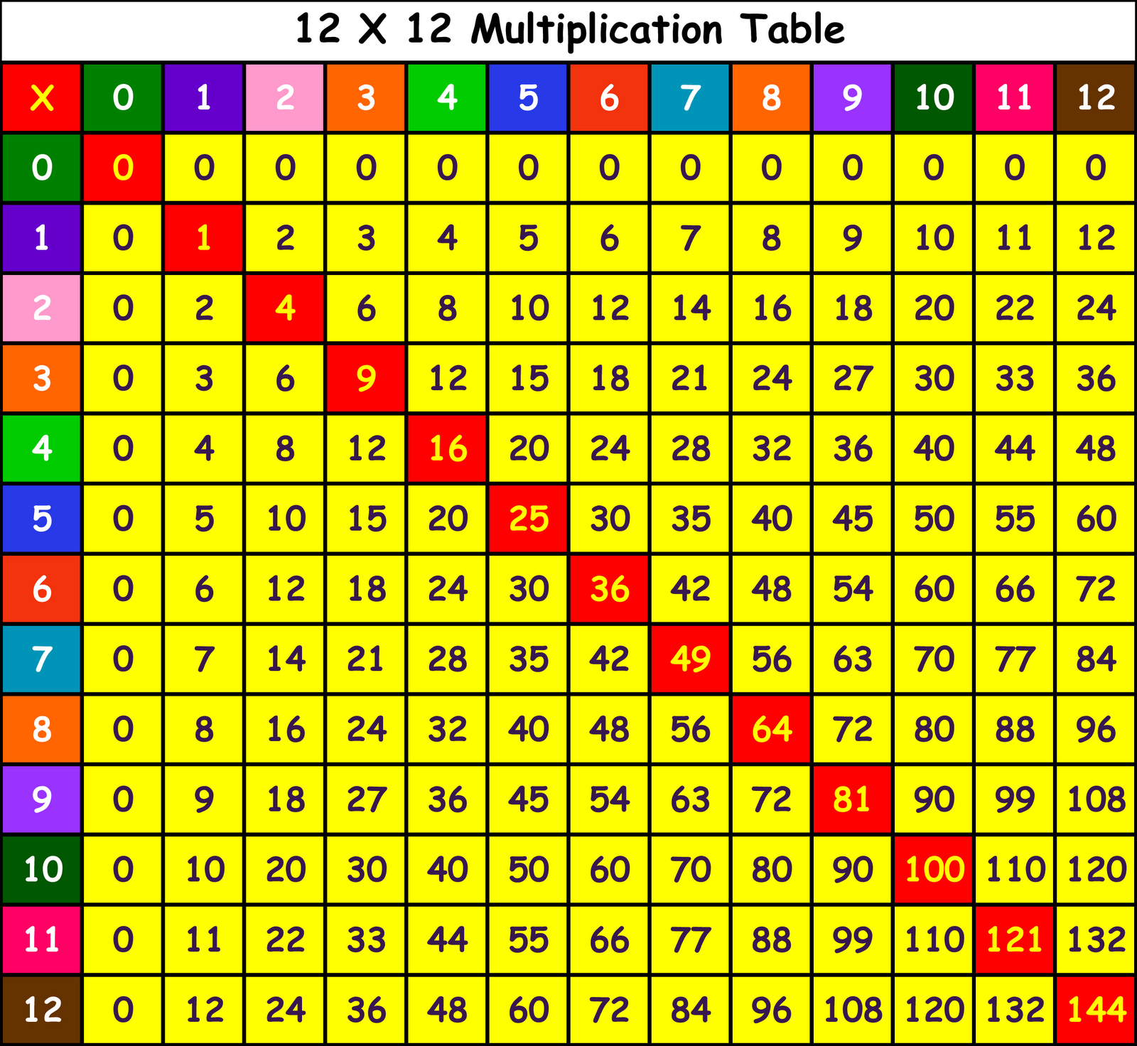

Slide 14
Models for multiplication
Lots of the ‘same thing’
Bead Bar
Number Line
0
3
6
9
12
Fingers
“3”
“6”
“9”
“12”
14
Notes:
Talk through the different models of multiplication outlined on this and the next slide, emphasising the importance of the bead bar in linking the cardinal and ordinal images of number.

Slide 15
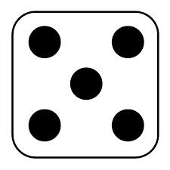
4 x 5 =
Count in steps of 2, 3, 5 and 10.
Chant /sing
Represent the fact
with objects or pictures
Recognise multiplication is commutative
4 x 5 is the same as 5 x 4
Notes:
This is 4 groups of 5
Most teachers would interpret it as 5 groups of, or lots of 5
The teacher in the later video teaches it as 4 groups of 5.
The two key structures for multiplication are multiple addition and scaling.
The model emphasised in most schools is multiple addition, at the expense of scaling
In the Netherlands their primary model is scaling and the children have a much greater sense of multiplication as a proportional operation and are more successful with fractions

Slide 16
Facts for free
8x3=24
24÷3=8
24÷8=3
Equivalent
facts
12x2=24
2x12=24
6x4=24
1x24=24
3x2x4=24
3x8=24
Nearby facts
3x7=21
3x9=27
4x8=32
2x8=16
Place value
30x8=240
30x80=2400
300x8=2400
0.3 x 8 = 2.4
0.3x0.8 = 0.24
Notes:
How many new facts can be derived from knowing just one fact?

Slide 17
Games to play
Throw and catch
Bingo
Pairs
How many in 1 minute?
Connect 3
Claim your squares

Slide 18
Other tips...
Little and often
Make it fun
Make up silly rhymes for tricky facts
Use what you know

Slide 19
Aims
Explain which number facts need to be learnt.
Share games and strategies to help your child derive, learn and recall number facts .
Thank you for coming.
Please complete the evaluation.

